Slide 2
We’re going to…

Slide 3
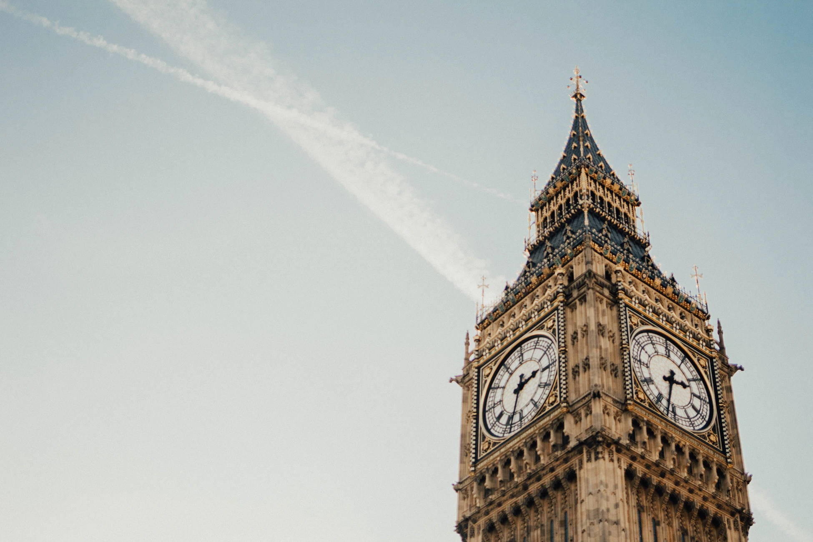
The Black Experience: London, Paris & Amsterdam
Start your journey in London where vibrant street life, centuries-old architecture, and the ringing chimes of Big Ben greet you. Cross the English Channel to Paris, where you will wander tree-lined boulevards and gaze up at the Eiffel tower, following in the footsteps of some of history’s greatest artists, philosophers, and writers who once experienced the city as students just like you. Round out your travels with time in Amsterdam, where colorful tulips, narrow canals, and smiling locals riding bicycles will welcome you.

Slide 4
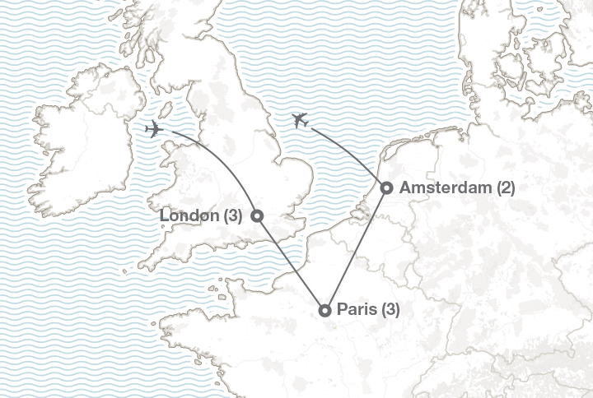
Our program
Designed to provide insight to the African diaspora, this program approaches the cultures, sites and rich histories of three European landmark cities through the lens of the Black experience. Through expert facilitated discussions and guided learning, topics such as change and continuity and historical significance will prompt new and engaging perspectives while inviting critical thinking about the evolution of these communities, their complex pasts, and vibrant presents.
Notes:
VO: XXXX country is off the coast of XX or next to XXX. Across this 9 day program, we’ll be spending X nights in XX, the capital of XXX, and then X night in XXX.

Slide 5
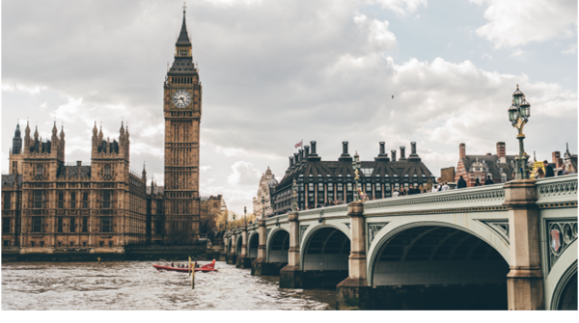
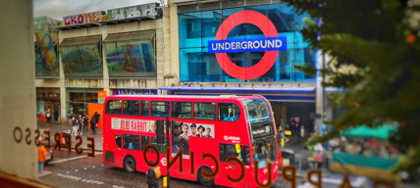
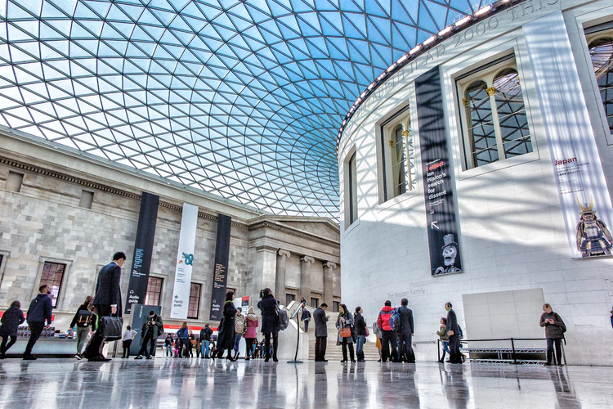
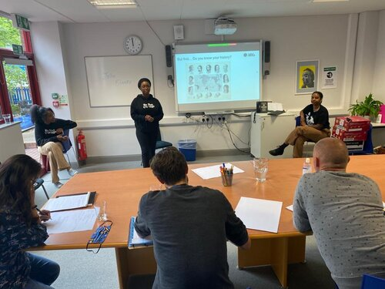
Tour London
See some of the city’s biggest sights, including Big Ben, London Bridge, Buckingham Palace and more through the lens of the Black experience on a guided walking tour
Explore Brixton
Brixton is an Afro-Caribbean cultural hub in London. It’s home to Electric Avenue, the first market street to be lit by electricity (yes, the same Electric Avenue as the 1983 hit song by Eddy Grant).
Visit the British Museum
The museum opened its doors for the first time in 1759, 17 years before the Declaration of Independence was signed.
Meet with The Black Curriculum
The Black Curriculum is an educational consulting organization focused on thoroughly integrating Black British history into schools across the United Kingdom.
Notes:
VO: To give you insight to our itinerary, I’ll walk you through some of the highlights of what you’ll see.
First, we’ll travel to XXX where you’ll see XXXX.
Then we’ll go to XXX. <Fact on slide>

Slide 6
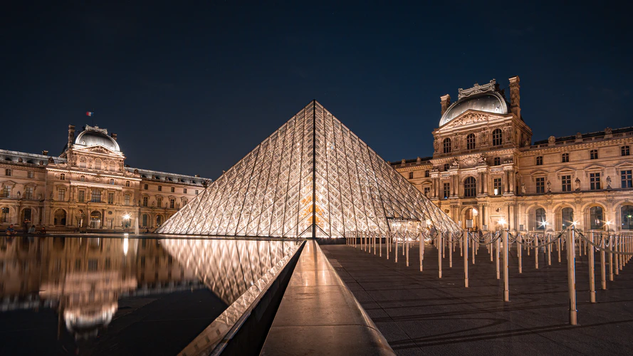
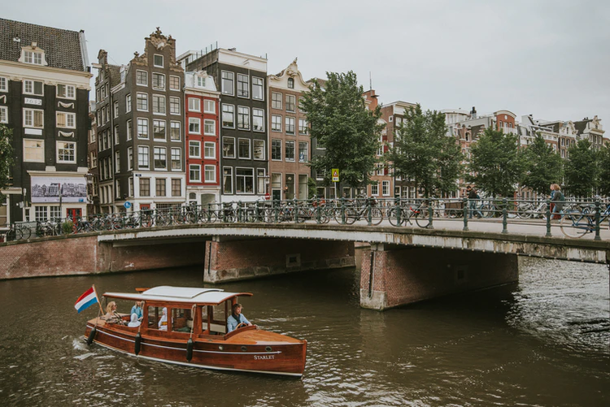
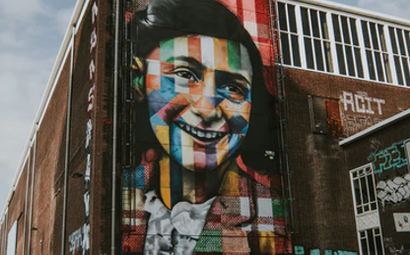
Explore the Louvre
Visit the Louvre with an expert guide focusing on artifacts and collections from Africa and the Diaspora.
Enjoy a Jazz Show
Did you know Jazz was first brought to Paris by Black American soldiers during World War I? Many famous Black jazz musicians spent time living and/or performing in Paris, including Miles Davis, Louis Armstrong and Billie Holiday.
Cruise the Canals of Amsterdam
See Amsterdam through the lens of the Black experience in the Netherlands on an expert-led tour and boat cruise.
Visit the Anne Frank House
Participate in an activity facilitated by the House aimed at broadening your understanding of, and engagement with, diversity, equity, inclusion and belonging.
Notes:
TOUR CODE SPECIFIC
FIRST COUNTRY HIGHLIGHTS
VO: To give you insight to our itinerary, I’ll walk you through some of the highlights of what you’ll see.
First, we’ll travel to XXX where you’ll see XXXX.
Then we’ll go to XXX. <Fact on slide>

Slide 7
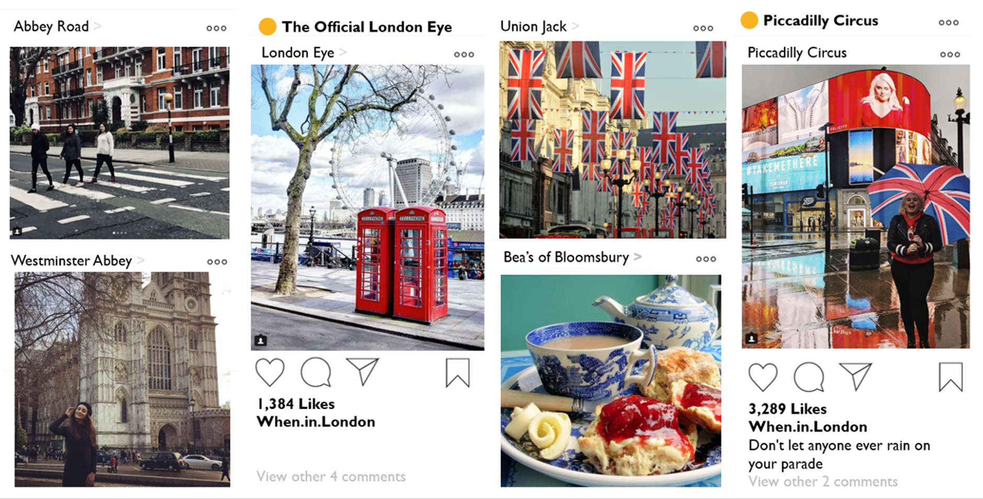
Notes:
VO: At the end of this X day trip, you’re bound to have some incredible Instagram and tiktok worthy memories, and a lot of stories to take home.

Slide 8
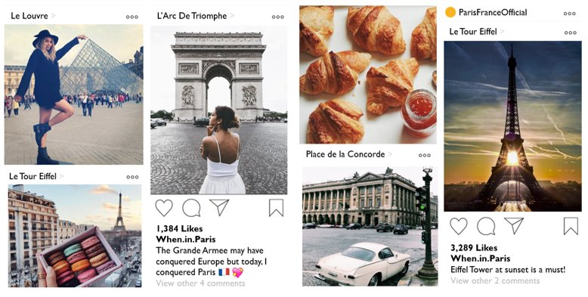
Notes:
TOUR CODE SPECIFIC
SOCIAL MEDIA WORTHY MEMORIES
VO: At the end of this X day trip, you’re bound to have some incredible Instagram and tiktok worthy memories, and a lot of stories to take home.

Slide 9
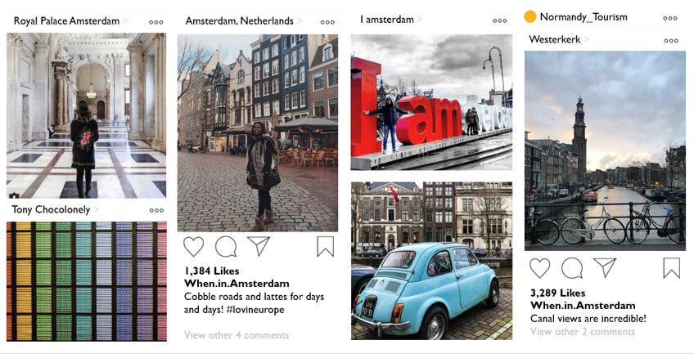

Slide 10
Notes:
VO NOTE: Before we dive in, I wanted to show you a quick video which paints a great picture of what the experience of traveling abroad is like.
Presentation Note: If you see a YELLOW bar on the top of the screen – make sure to hit “ENABLE CONTENT” to ensure this video will play. Sometimes you may need to play it in SlideShow mode WITHOUT the Presenter View
Click video to play
If video gives you issues in browser: copy & paste the following into the browser: https://www.youtube.com/watch?v=HULBRF65CJs&t=3s

